Slide 1
Twitter Sentiment Analysis #Brexit
Presented By:
Poonam Dhoot – 10399137
Sunmeet Thapar - 10506082

Slide 2
Introduction
Sentiment Analysis is the process of ‘computationally’ determining weather a piece of writing is positive, negative or neutral
Also known as Opinion Mining
Source
Twitter
Topic
#Brexit
Tools Used
Rapid Miner
Plugins
AYLIEN Text Analysis

Slide 3
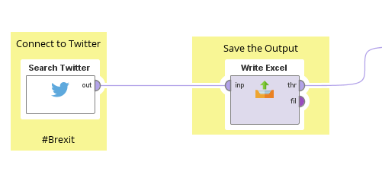
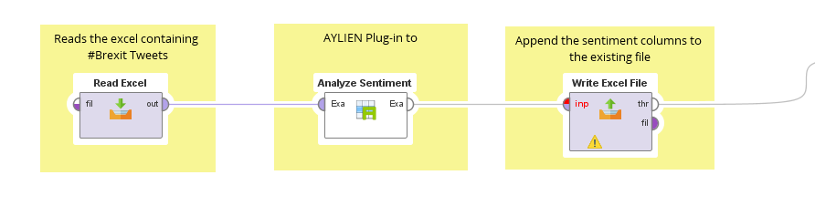
Data Understanding

Slide 4
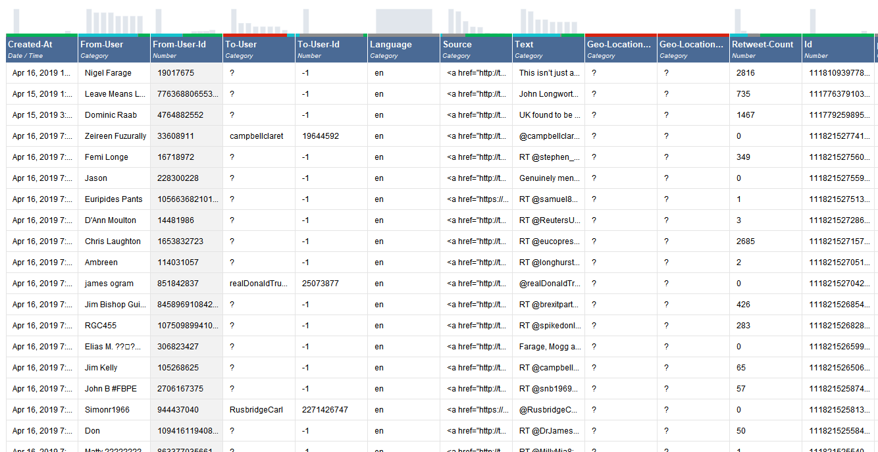
Data Understanding(cont.)

Slide 5
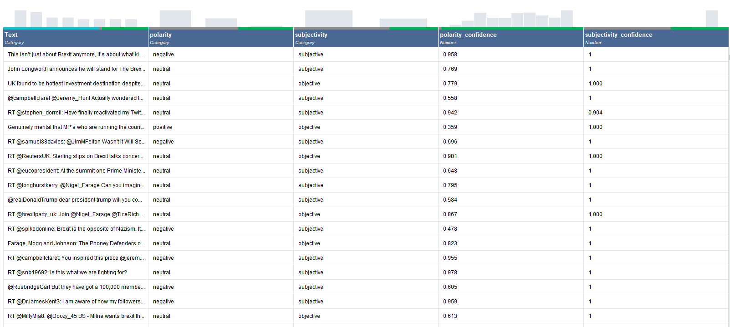
Data Understanding(cont.)

Slide 6
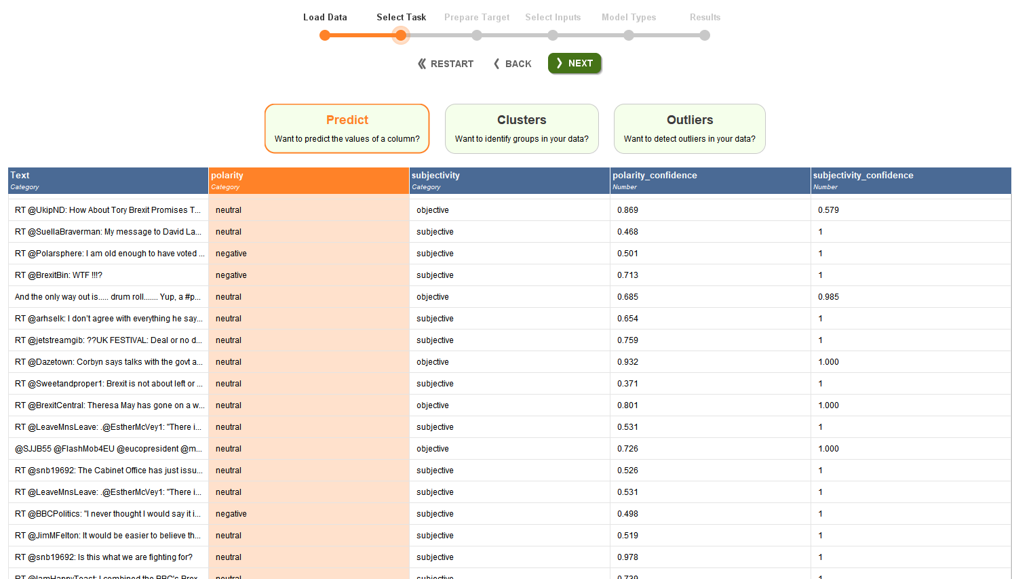
Data Preparation

Slide 7
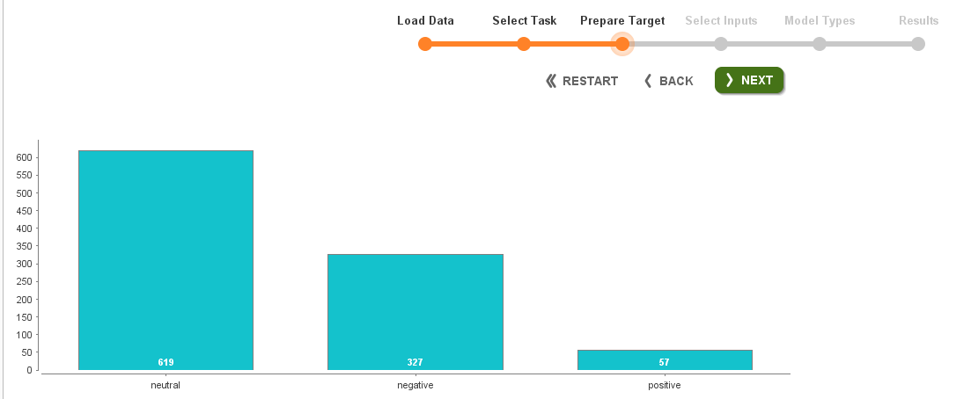
Data Preparation(cont.)

Slide 8
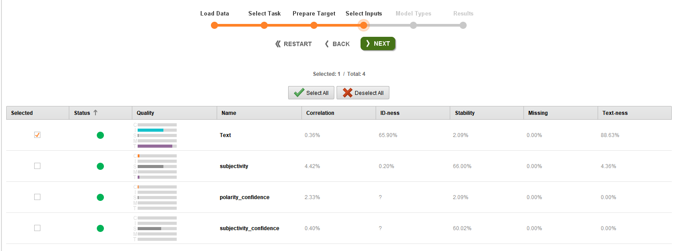
Modeling

Slide 9
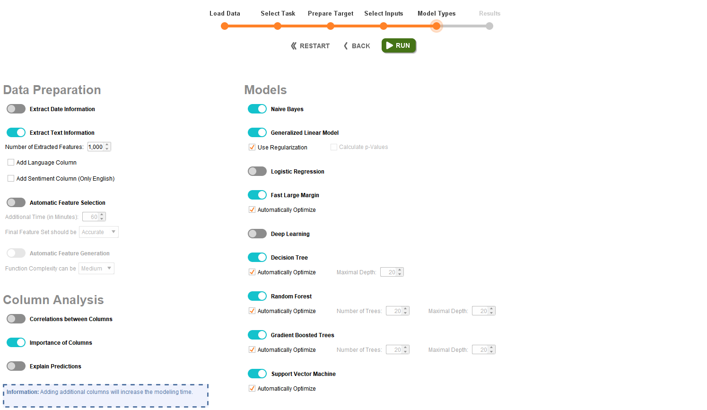

Slide 10
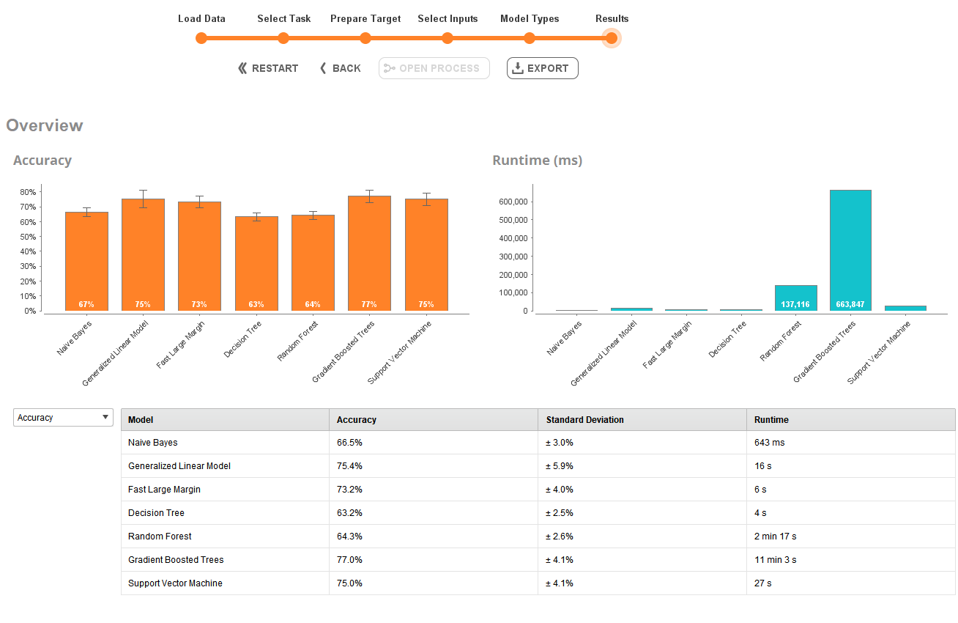
Evaluation

Slide 11
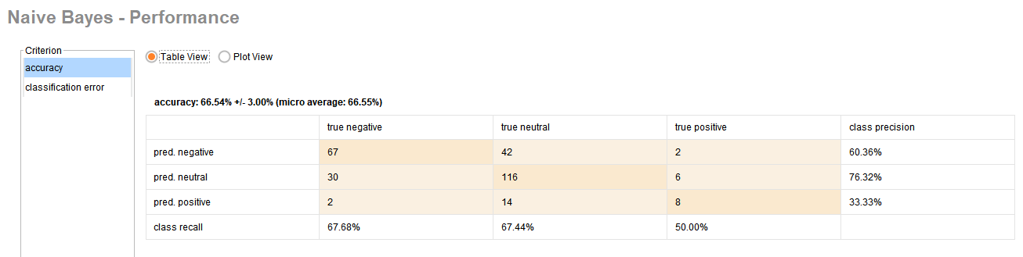
Evaluation(cont.)

Slide 12
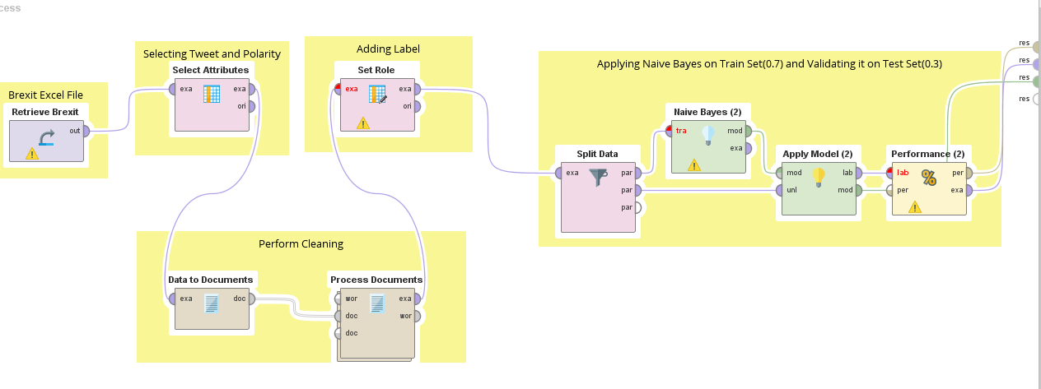
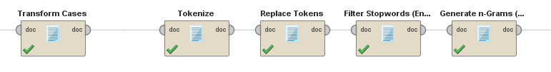
Deployment
Process Documents – Sub-Process

Slide 13
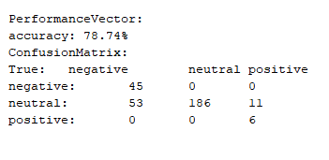
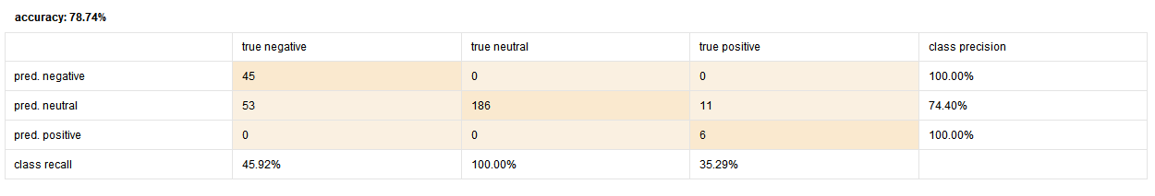
Performance Vector

Slide 14
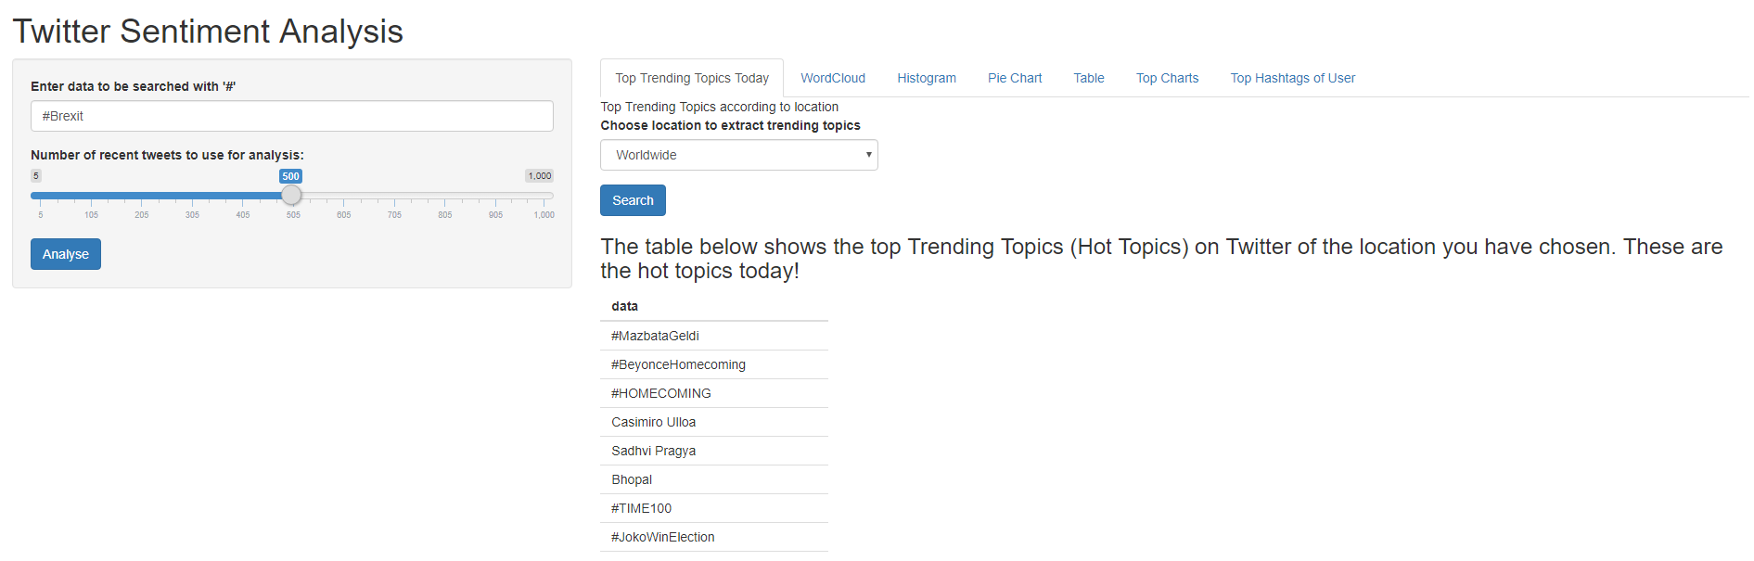
R Shiny Visualization

Slide 15
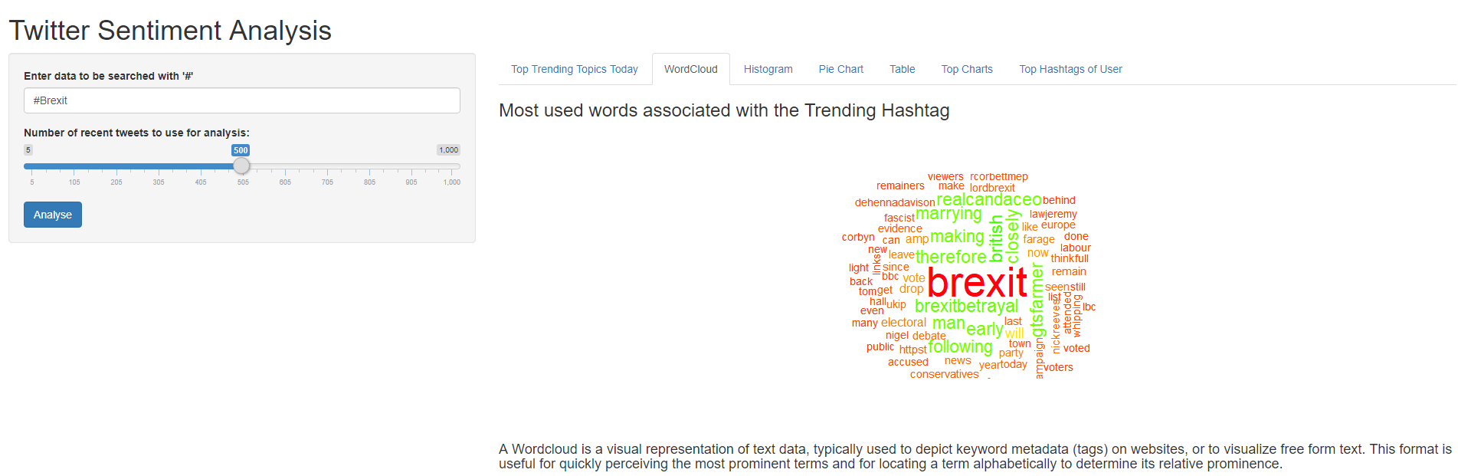
R Shiny Visualization(cont.)

Slide 16
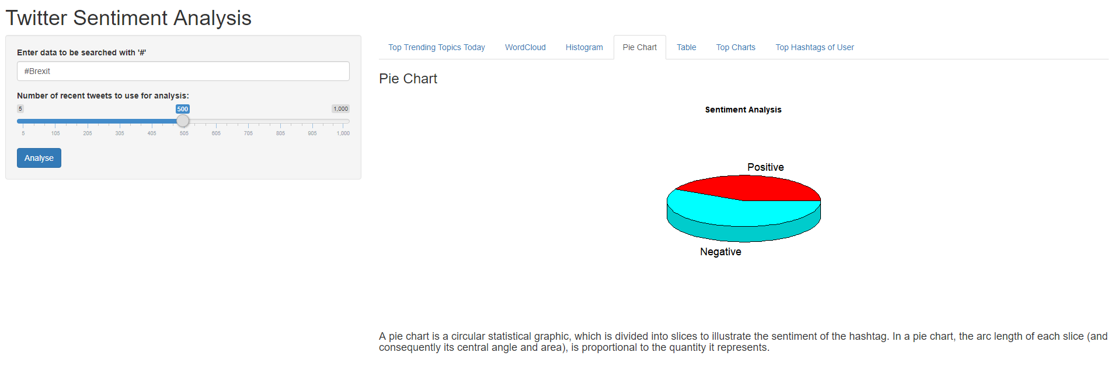
R Shiny Visualization(cont.)

Slide 17
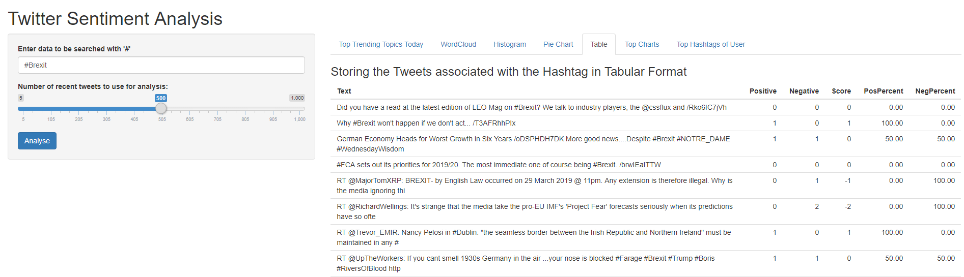
R Shiny Visualization(cont.)

Slide 18
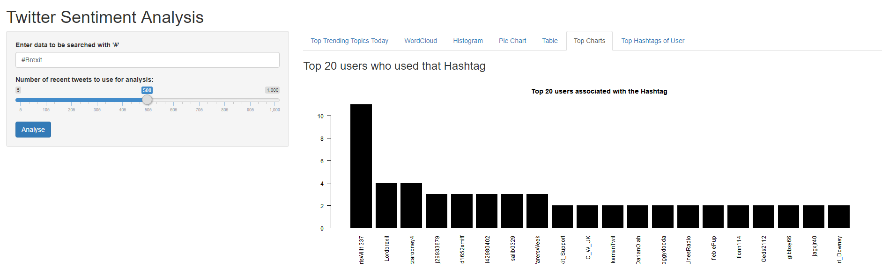
R Shiny Visualization(cont.)

Slide 19
Thank You

